Slide 1
CloudSat intro & data processing

Slide 2
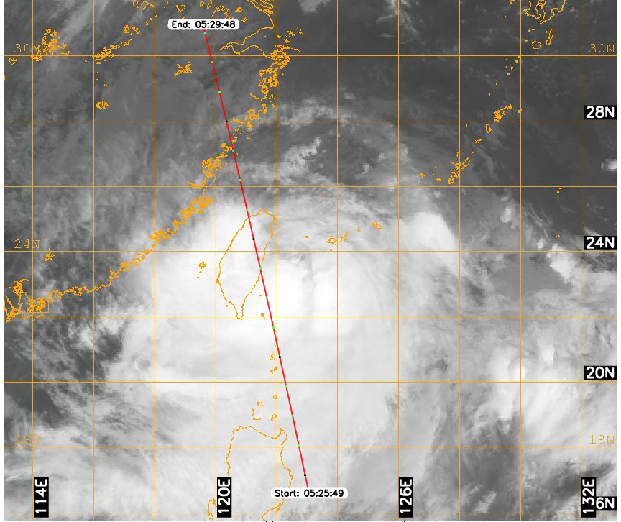
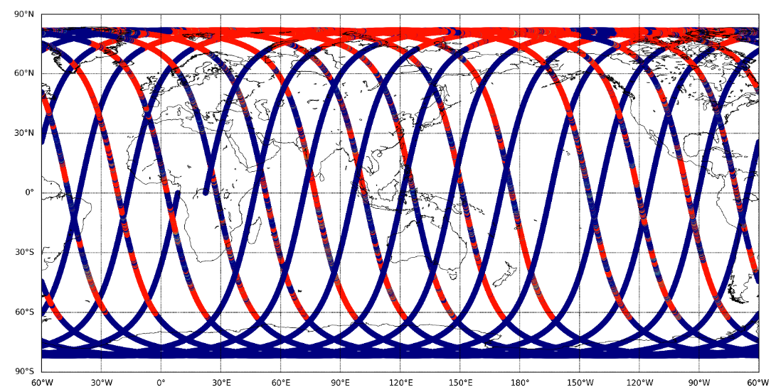
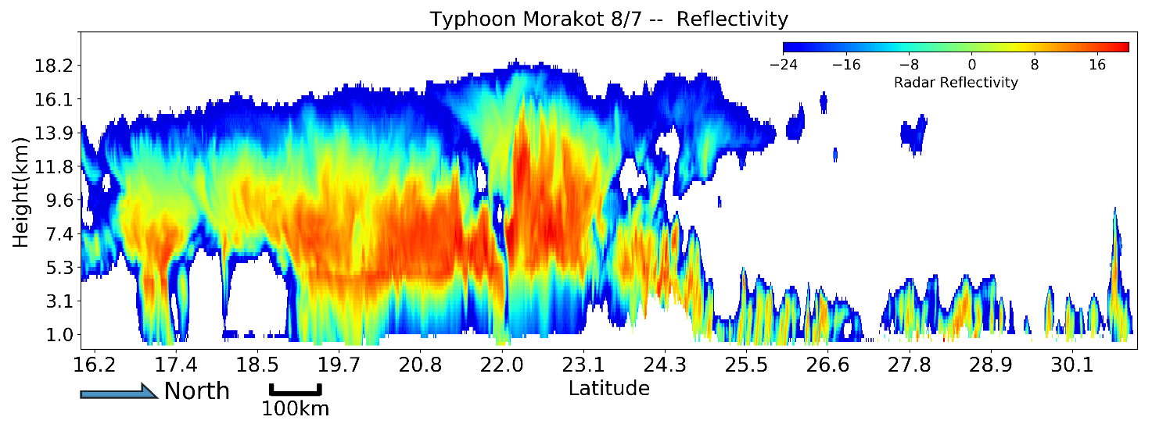
CloudSat
Typhoon Morakot 2009/8/7
Polar-orbiting satellite; launch at 2006/04/28; stop operation at 2023/12/20
Cross the equator at local time 1:30 pm and 1:30 am
Due to battery malfunction: only day-time have observation after 2011
Cloud Profiling Radar (CPR): sensitive to larger hydrometeors
high resolution vertical profile cross the atmosphere
Vertical resolution: 240m; Horizontal resolution (alone track): 1.8km
~15 tracks in one day; ~44,000 swaths for ten years observation
Weakness:
Narrow observation domain; Temporal resolution is limited
CloudSat track in one day
Cloud mask & Reflectivity

Slide 3
Data folder
CloudSat (hdf files):
cloud frequency
/data/dadm1/obs/CloudSat/hdf-GEOPROF/
2015089071752_47449_CS_2B-GEOPROF_GRANULE_P_R04_E06.hdf
/data/dadm1/obs/CloudSat/hdf-GEOPROF-LIDAR/
2006262131322_02100_CS_ECMWF-AUX_GRANULE_P_R04_E02.hdf
cloud radiative effect (optional)
/data/dadm1/obs/CloudSat/hdf-FLXHR-LIDAR/
2014188163349_43581_CS_2B-FLXHR_GRANULE_P2_R04_E06.hdf
File name example:
2015089071752_47449_CS_2B-GEOPROF_GRANULE_P_R04_E06.hdf
2B-GEOPROF
2B-GEOPROF-LIDAR
2B-FLXHR-LIDAR
Year
Julian Day
UTC time
Granule
Product name
…

Slide 4
Preperation
Pyhdf
conda install -c conda-forge pyhdf
### hdf file package:
from pyhdf.SD import SD, SDC
from pyhdf.V import *
from pyhdf.HDF import *
Basemap
conda install -c anaconda basemap
###drawing package:
import os
os.environ['PROJ_LIB'] = 'D:\\program\\anaconda3\\Library\\share\\'
from mpl_toolkits.basemap import Basemap
satellite_read_tool.py
HDFvars (print .hdf file vars in SDS field), region_latlon2grid (EC grid), rFilter (CloudSat regional filter), lat_lon_trmm (trmm grid), CWV_bin, merge_fun

Slide 5
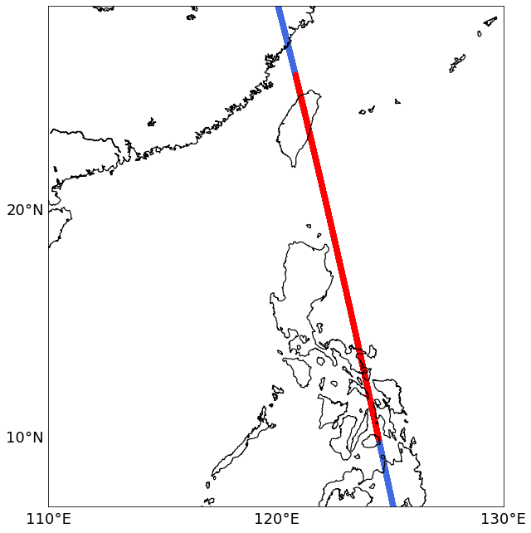
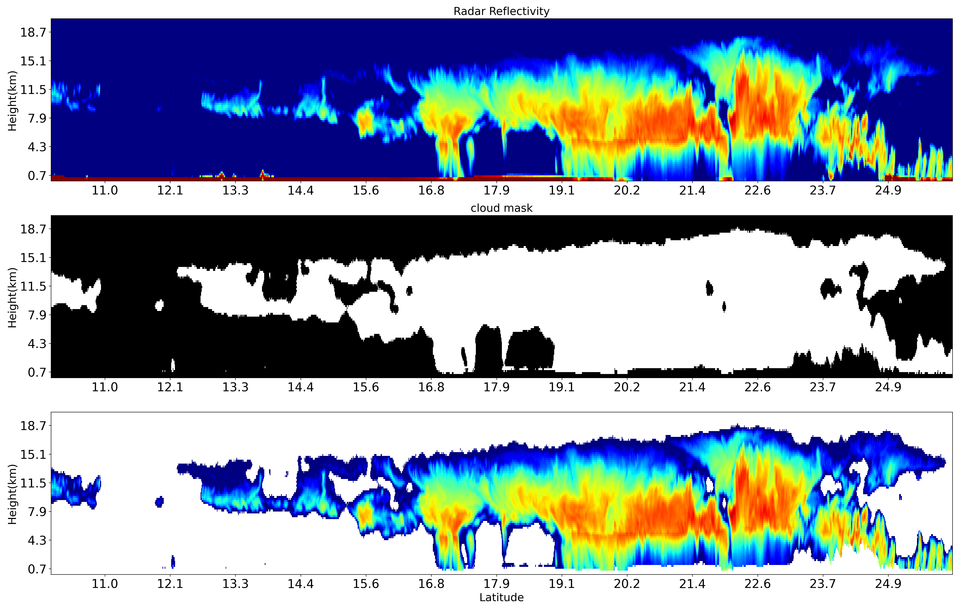
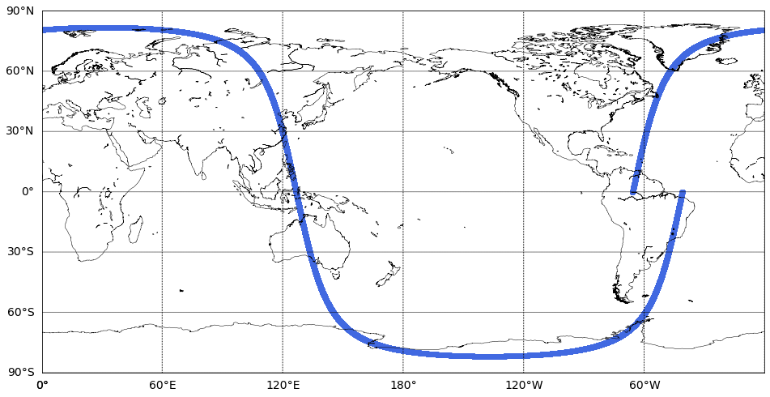
Cloudsat practice
What we should learned from the tutorial:
Load single file variables (e.g. GEOPROF, GEOPROF-LIDAR, FLXHR-LIDAR)
Filter the data to focus on specific region
Plot different variables along the track
Re-grid to 2D-grid (self-defined latitude resolution or ECMWF-pressure grid)
Do some statistics (e.g. cloud frequency)
Combine different product (e.g. GEOPROF & GEOPROF-LIDAR)

Slide 6
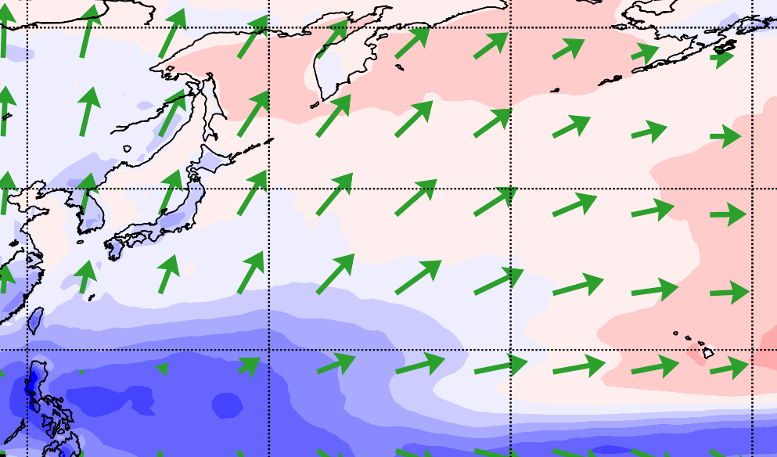
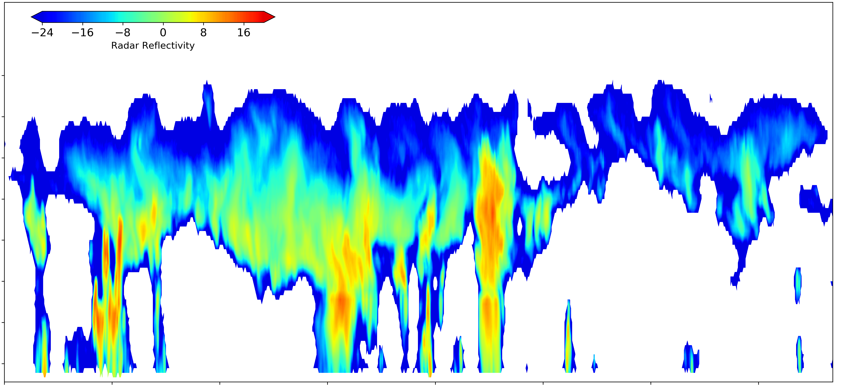
Cloudsat practice
What we should learned from the tutorial:
Load single file variables (e.g. GEOPROF, GEOPROF-LIDAR, FLXHR-LIDAR)
Filter the data to focus on specific region
Plot different variables along the track
Re-grid to 2D-grid (self-defined latitude resolution or ECMWF-pressure grid)
Do some statistics (e.g. cloud frequency)
Combine different product (e.g. GEOPROF & GEOPROF-LIDAR)
60N
40N
20N
200
225
80%
75%
80%
Pressure
95%
0%
10%
450
500
825
850
75%
15%
0%
CloudSat swaths

Slide 7
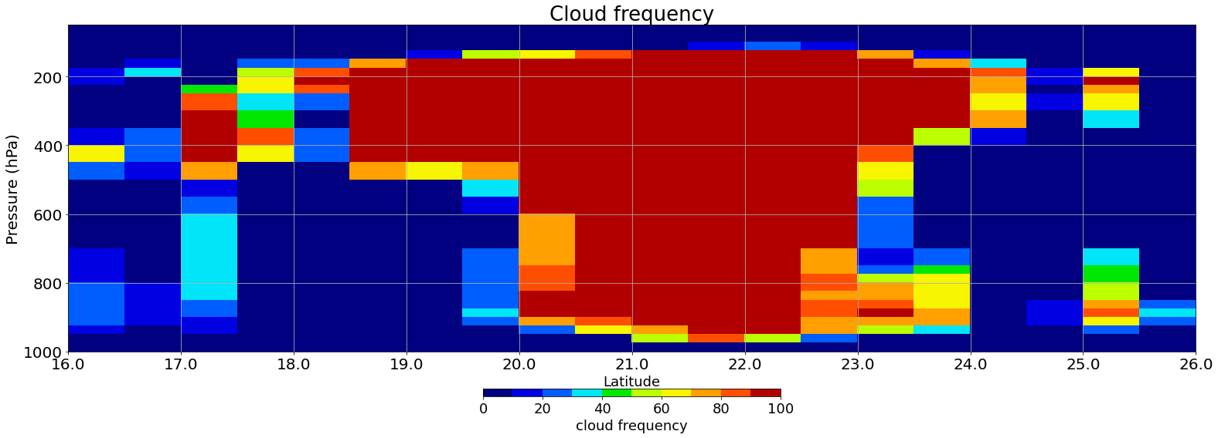
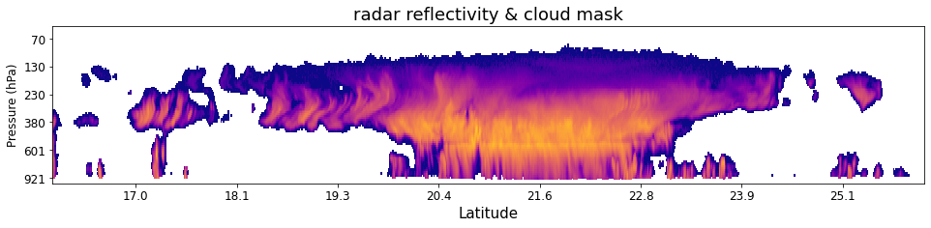
Cloudsat practice
What we should learned from the tutorial:
Load single file variables (e.g. GEOPROF, GEOPROF-LIDAR, FLXHR-LIDAR)
Filter the data to focus on specific region
Plot different variables along the track
Re-grid to 2D-grid (self-defined latitude resolution or ECMWF-pressure grid)
Do some statistics (e.g. cloud frequency)
Combine different product (e.g. GEOPROF & GEOPROF-LIDAR)

Slide 8
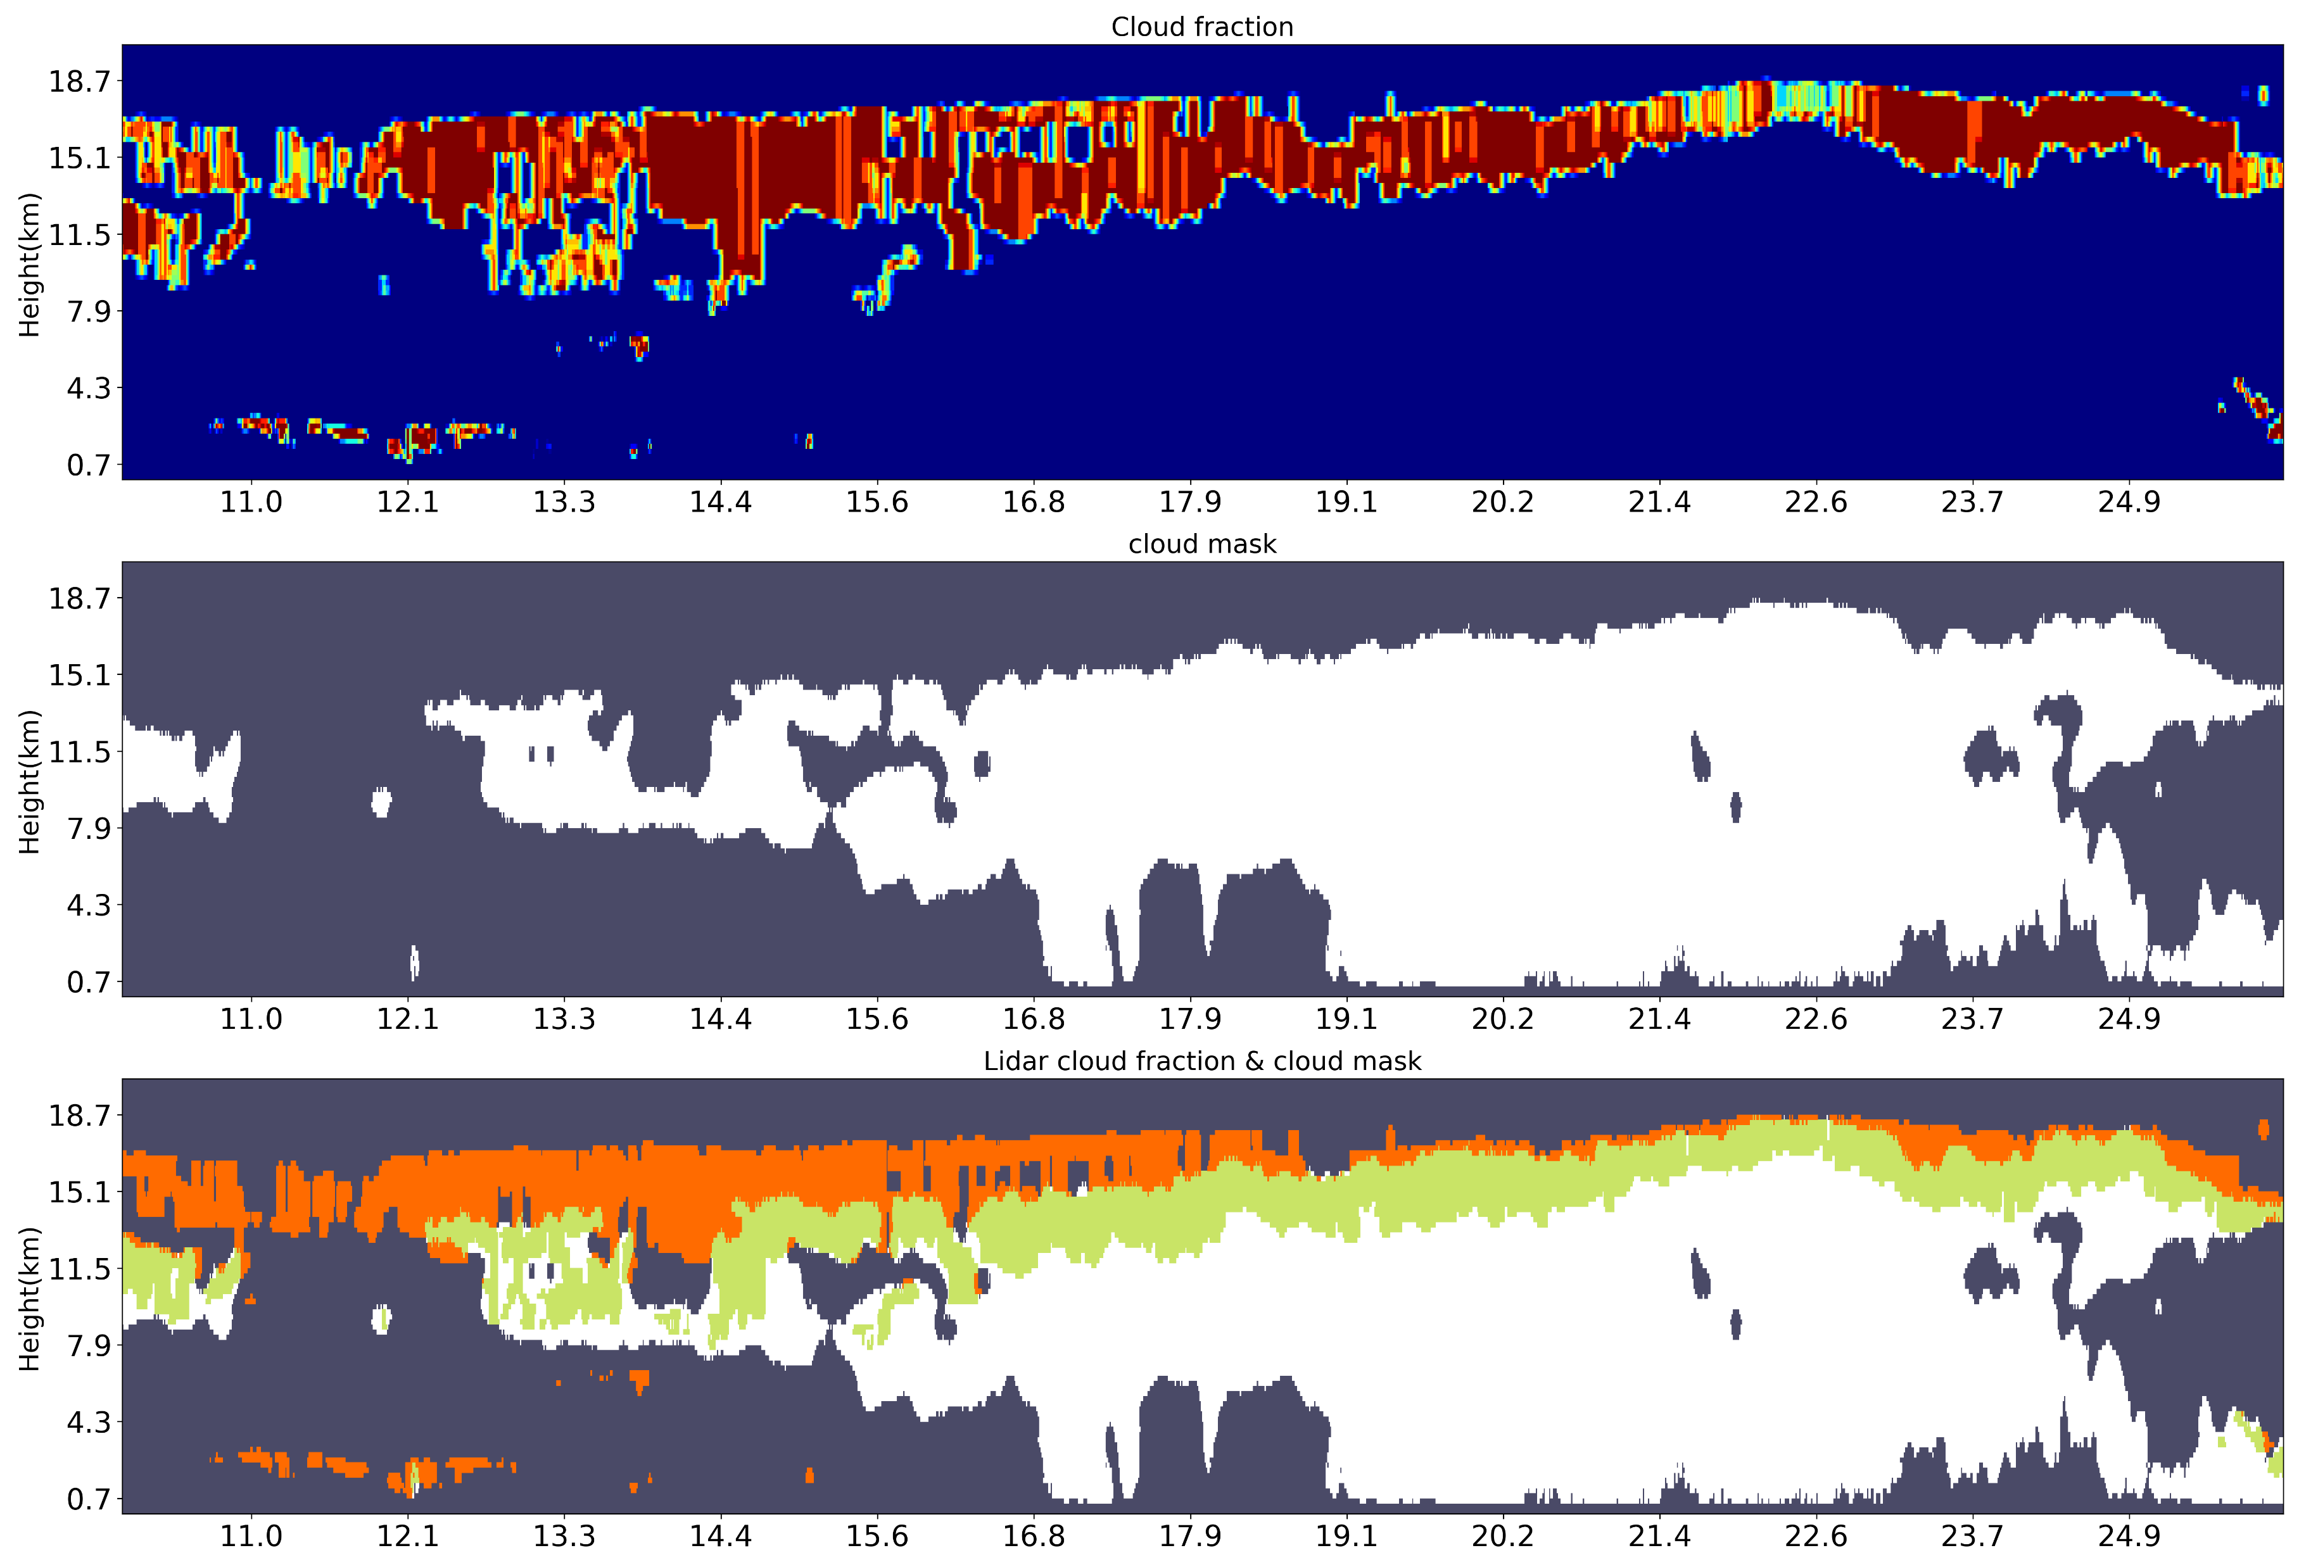
Cloudsat practice
What we should learned from the tutorial:
Load single file variables (e.g. GEOPROF, GEOPROF-LIDAR, FLXHR-LIDAR)
Filter the data to focus on specific region
Plot different variables along the track
Re-grid to 2D-grid (self-defined latitude resolution or ECMWF-pressure grid)
Do some statistics (e.g. cloud frequency)
Combine different product (e.g. GEOPROF & GEOPROF-LIDAR)

Slide 9
https://www.cloudsat.cira.colostate.edu/
https://github.com/jerryjerry9/CloudSat-2023
Some variables we may use
GEOPROF: CPR_Cloud_mask (>20=Cloud detected); Radar_Reflectivity (Reflectivity: -40~50)….
GEOPROF-LIDAR: CloudFraction (Lidar data re-grid to CPR: 0~100)….

Slide 10
Some important quality check variables
Data quality (nearly all products)
Dimensions: nray (alone tracks)
Flags indicating data quality. If 0, then data is of good quality.
Otherwise, treat as a bit field with 8 flags:
0: RayStatus_validity not normal.
1: GPS data not valid.
2: Temperatures not valid.
3: Radar telemetry data quality is not normal.
4: Peak power is not normal.
5: CPR calibration maneuver. 6: Missing frame.
7: Not used.
UncertaintyCF (GEOPROF-LIDAR)
Missing value: -9
Dimensions: nbin,nray (vertical bins*alone tracks)
The UncertaintyCF is a description of the quality of radar and lidar data. It is recorded per ray and per bin as 1-byte integer.
0 means that neither radar data nor lidar data was found.
1 indicates that only radar data has been found.
2 indicates that only lidar data has been found.
3 indicates that both radar data and lidar data were found.

